Slide 1

AI 'slop' is transforming social media - and a backlash is brewing
Week of April 13
Jacob Appling

Slide 2
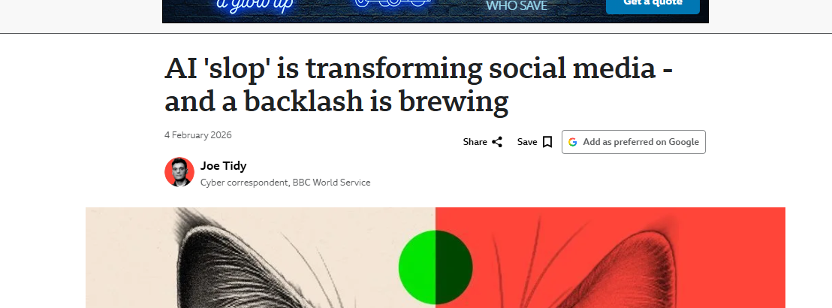
Article #4 (Row 4 via Google Sheet)

Slide 3
Link to the Source
https://www.bbc.com/news/articles/c9wx2dz2v44o

Slide 4
Main Findings
Social media platforms are being flooded with large amounts of low-quality, AI-generated content, often called “AI slop.”
Major platforms are helping accelerate this trend by making AI creation toolseasier to use and more common; one cited example was that over one millionYouTube channels used AI tools in a single month.
The article also points to measurable scale: Kapwing research cited in thecoverage said about 20% of content shown to new YouTube accounts was“low-quality AI video.”
Even though some creators are making real money from this material, users arestarting to push back because feeds feel more fake, repetitive, and low-value.

Slide 5
Broader implications for society
The spread of AI-generated junk content could make the internet less trustworthy, because people may have a harder time telling what is real, useful, or human-made. This is a reasonable inference from the article’s focus on user frustration and low-quality AI content overtaking feeds.
People may tolerate AI content differently depending on why they use a platform: for entertainment it may matter less, but for learning, information, or community it becomes more problematic.
There may be growing public pressure for better moderation, labeling, and filtering tools as AI content becomes more widespread. That follows from the article’s emphasis on backlash and platform concerns about removal systems.
The issue may be especially concerning for younger audiences, since related reporting describes low-quality AI media as a serious problem in children’s content ecosystems.

Slide 6
Relevance and potential influence on the construction industry
Construction firms could face the same “signal vs. noise” problem if AI starts producing too much low-quality marketing, training, safety, or project communication content. This is an inference, but it fits the article’s warning about content overload.
AI can still be useful in construction, but this article suggests companies will need quality control so AI-generated reports, visuals, schedules, or summaries are accurate and not just fast.
For construction communication, credibility matters. Owners, contractors, and teams may become more skeptical of polished visuals or documents unless firms can show they are reliable and reviewed by humans. This is an inference from the article’s broader trust concerns.
In practical terms, the article supports using AI as an assistant rather than letting it mass-produce unchecked content, especially in areas like safety messaging, training, and project updates where accuracy matters.

